Slide 1
The Relationship between Financial Satisfaction, Job Satisfaction, and Happiness for Different Social Classes
By: Carrie Magee, Abhimanyu Barun, Ambar Pathak, and Kismat Khatri

Slide 2
Table of contents
01.
02.
03.
Introduction
Descriptive Statistics
Statistical Analysis
04.
05.
06.
Graphical Representation
Time Series Analysis
Conclusion

Slide 3
SMART Question
How do individuals’ level of satisfaction with their job and financial situation relate to their general level of happiness across the USA from 1972 to 2021?

Slide 4
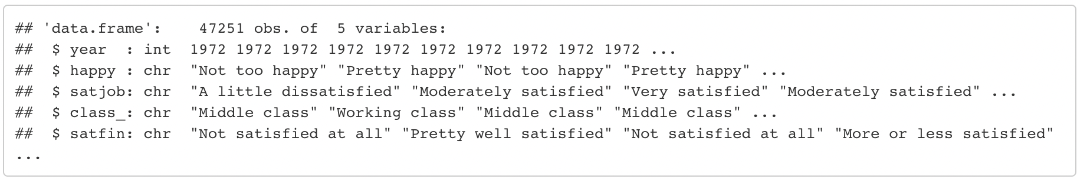
Data Set: General Social Survey
Source: https://gssdataexplorer.norc.org/home

Slide 5
Introduction
01

Slide 6
Abstract
The pursuit of well-being is a crucial socio economic objective for society as a whole because it results in the happiness of each person. In this regard, it's crucial to research what influences people's happiness the most. In principle, these factors are associated with level of financial satisfaction and job satisfaction. Our exploratory data analysis examines how Americans' happiness is influenced by their level of financial satisfaction and job satisfaction across social classes.

Slide 7
02
Descriptive Statistics

Slide 8
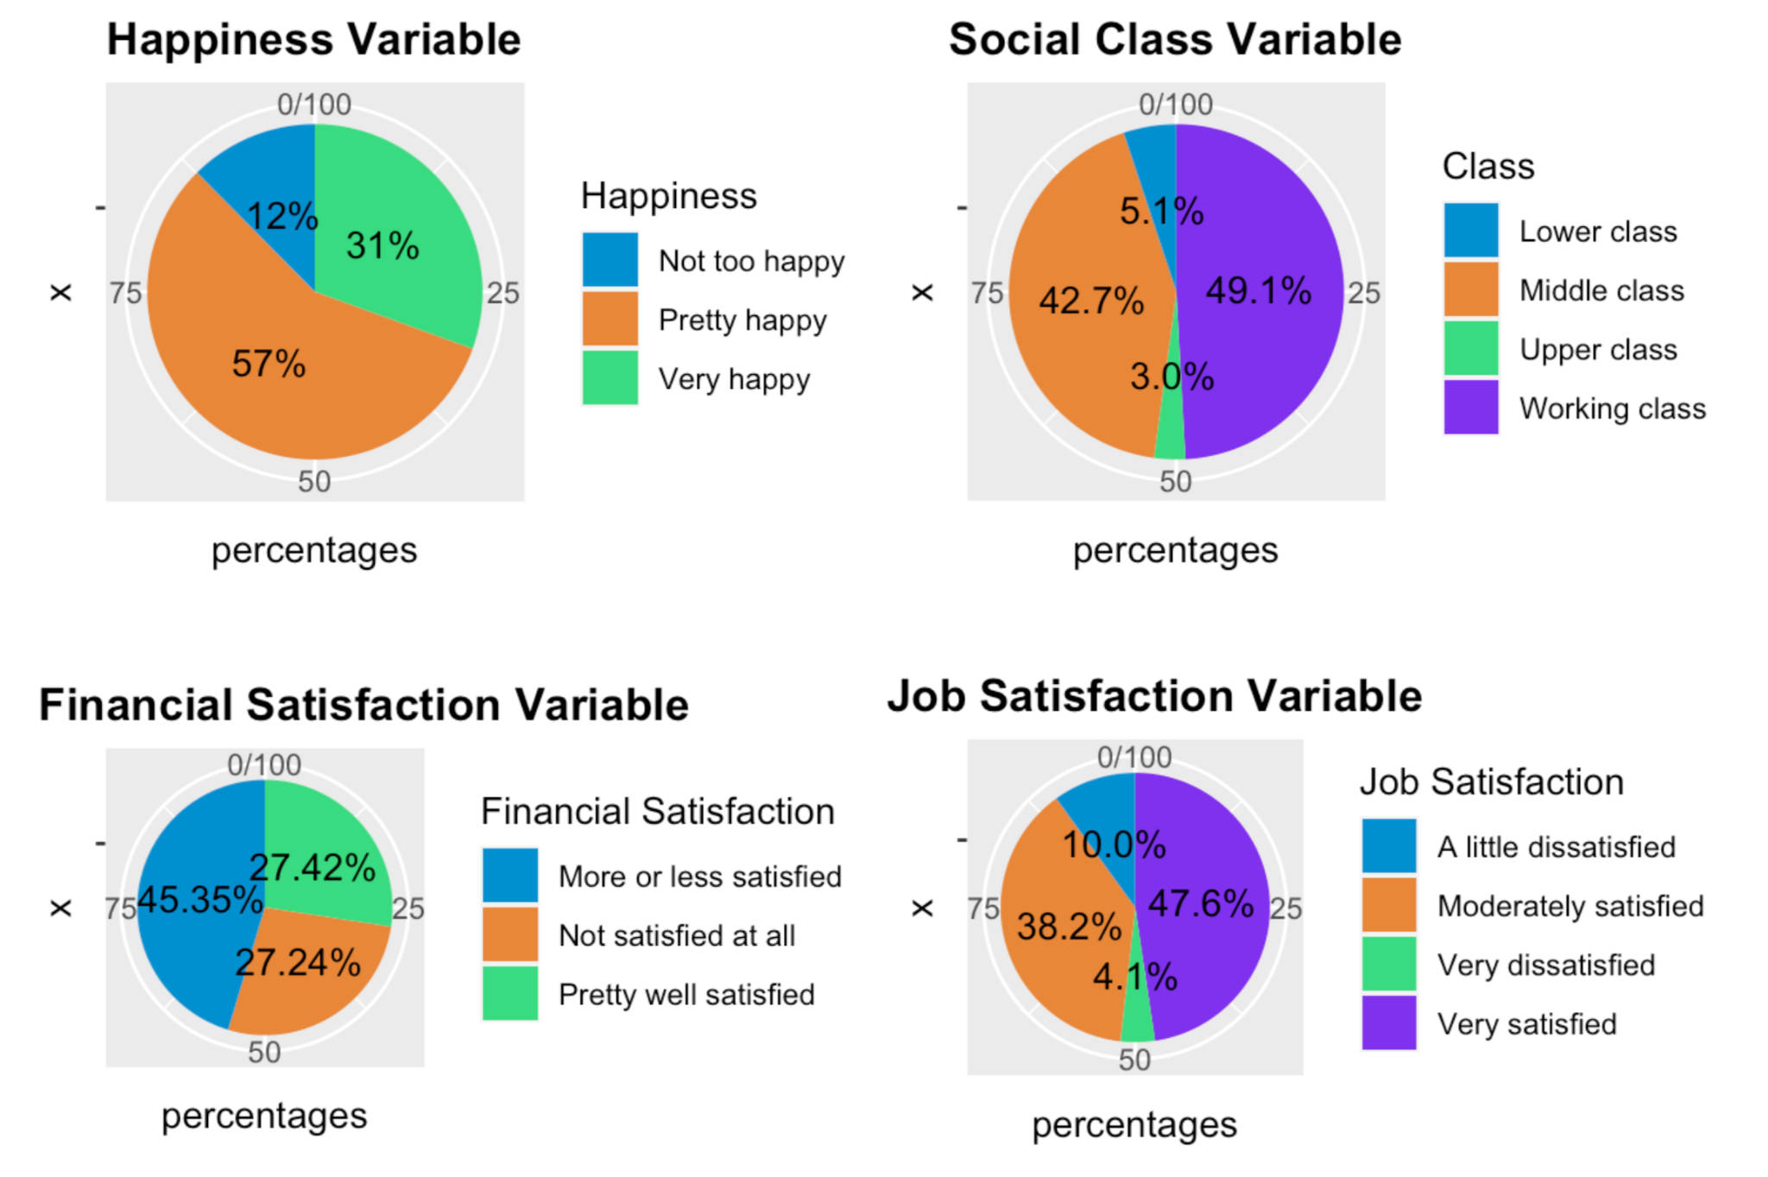
Happiness and Social Class Variables
About 57% of people reported being pretty happy
31% of people reported being very happy
12% of people reported being not too happy
49.1% of people identified as part of the working class
43% of people reported to be part of the middle class
5.1% of the people identified as part of the lower class
3.0% reported as being part of the upper class
Notes:
The first pie chart shows the more than half of the people are pretty happy(i.e 57%) from 1972 to 2021 whereas the american's people who are very happy and not too happy are 31% and 12% respectively.
The second pie chart shows the classes of people of America. It show that nearly half of the people fall under working class and about 43% people are middle class in America. The american's people who fall under upper and lower class are very less than other two classes i.e 3% and 5.1%.
The third pie chart shows that nearly half of the people are more or less satisfied with their financial status i.e 46% approximately whereas about same percentage (about 27%) of people are pretty well satisfied and Not satisfied at all with their Financial status.
The last pie chart shows about 48% of american people's are very satisfied with their job whereas a little people are dissatisfied with their job i.e 4.1%. The percentage of people who are a little dissatisfied and moderately satisfied are 10% and 38.2% respectively.

Slide 9
Financial and Job Satisfaction Variables
45.35% of people reported being more or less satisfied with their financial situation
About 27% of people reported being not satisfied at all and pretty well satisfied with their financial situation
48% of the sample are very satisfied with their job
4.1% of people are dissatisfied with their job
10% of people reported being a little dissatisfied with their job
38.2% of people reported being moderately satisfied with their job

Slide 10
Statistical Analysis
03

Slide 11
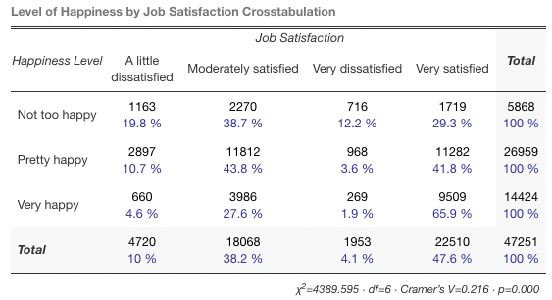
Job Satisfaction and Happiness
12.2% of individuals who reported being very dissatisfied with their job were “not too happy” in life
19.8% of those with a little job dissatisfaction were also “not too happy”
43.8% of individuals who were moderately satisfied with their job were “pretty happy”
65.9% of individuals who were very satisfied with their job were “very happy” in life
Happiness depends on an individual’s job satisfaction (p<0.05)
Notes:
Considering that individuals who reported being more dissatisfied (on the more dissatisfied side) with job also reported being unhappy and those who reported being more satisfied were more happy shows that job satisfaction may play a crucial role in how happy individuals are in life.

Slide 12
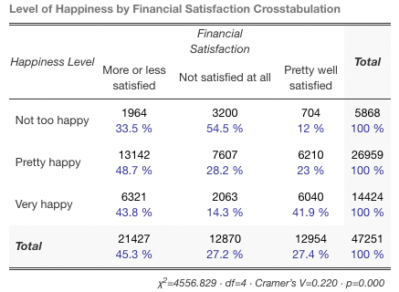
Financial Satisfaction and Happiness
Happiness depends on degree of financial satisfaction (p < 0.05)
54.5% of individuals that reported being not at all satisfied with their financial situation were “not too happy” in life
48.7% of individuals that were more or less satisfied with their financial situation were “pretty happy”
41.9% of individuals that were pretty well satisfied with their financial situation reported being “very happy” in their life
Notes:
So as we can see the more financially satisfied someone was the more happy they were and vice versa so it just shows that financial satisfaction and security can be really important for how happy an individual is in life.

Slide 13
Graphical Representation of Data
04
Notes:
We wanted to look even deeper into these relationships by looking at satisfaction and happiness across social classes because social class is such a prominent divide between people and really forumate peoples perspective on their life and thus why we think they may be big differences in their happiness.

Slide 14
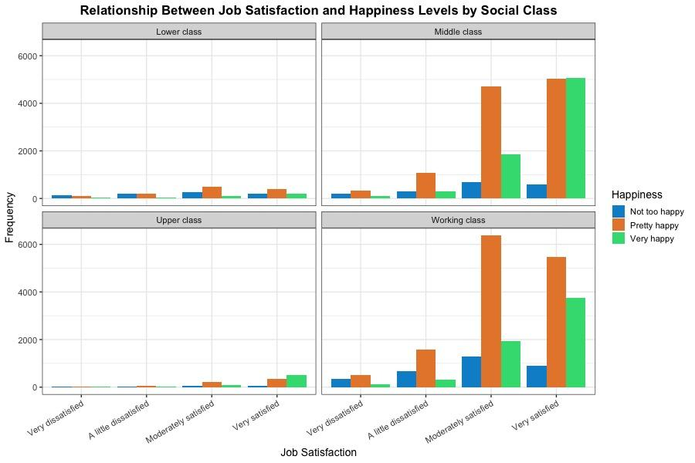
Job Satisfaction and Happiness by Social Class
Lower Class
Working Class
Middle Class
Upper Class
Moderately satisfied with job
Pretty happy
Moderately satisfied with job
Pretty happy
Very satisfied with job
Equally pretty happy and very happy
Very satisfied with job
Very happy
Notes:
So we can see that the higher in class you go the more satisfied and more happy you are.
Lower and working class are different from middle and upper class in terms of job satisfaction and happiness but upper class shows this extreme positive trend in happiness and job satisfaction where a majority of individuals are very satisfied and very happy while so class may be a big influence on happiness level
We se

Slide 15
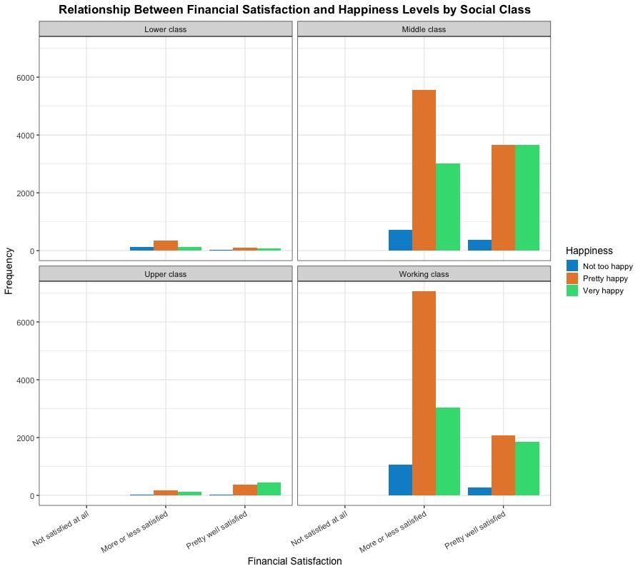
Financial Satisfaction and Happiness by Social Class
Lower Class
Working Class
Middle Class
Upper Class
More or less satisfied with financial situation
Pretty happy
More or less satisfied with financial situation
Pretty happy
More or less satisfied with financial situation
Pretty happy
Pretty well satisfied with financial situation
Very happy
Notes:
As we can see, the results show that the higher the social class the more you become satisfied with your financial situation and the more you report being very happy while the more you go down in class, the more your satisfaction and happiness become average (as in more or less satisfied and pretty happy).
So in this case financial satisfaction and social class kinda go more hand in hand here which is why we see such a big divide between the lower, working, and middle class and upper class.
I think it’s good to reiterate that the overall trends were saw were that the higher your feelings of satisfaction the more happy you also report being and this relationship is exaggerated when we look at it among social class. → so we know that satisfaction plays a role in

Slide 16
05
Time Series Analysis

Slide 17
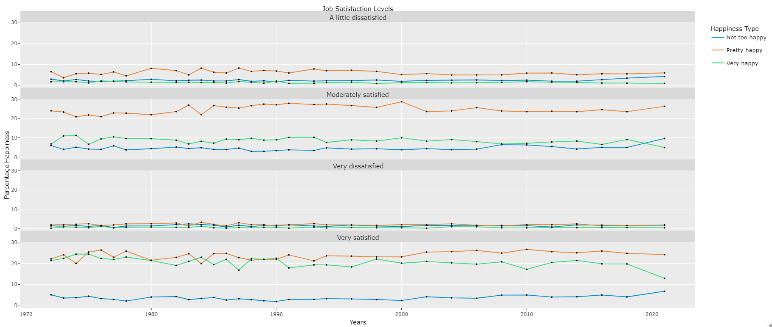
Happiness over Years by Job Satisfaction

Slide 18
Very Dissatisfied
A Little Dissatisfied
Moderately Satisfied
Very Satisfied
Happiness over Years by Job Satisfaction
Happiness levels are negligible.
Value never crosses the 5 percent mark from 1972 to 2021.
Moderately happy.
Hits peak of moderate happiness percentage in 1980, 1984, 1987, and 1993
No happiness type crosses 10 percent mark.
Moderate happiness (on the higher side)
It fluctuates between 1982 and 1984 after regaining its position in 1985 and maximizes in the year 2000
The extreme ends of happiness(not happy and too happy) are in the lower tens of percentage
Show higher happiness levels and relatively lower unhappiness levels
The very happy value crosses the moderately happy value on 4 occasions: 1974, 1984, 1988, and 1990

Slide 19
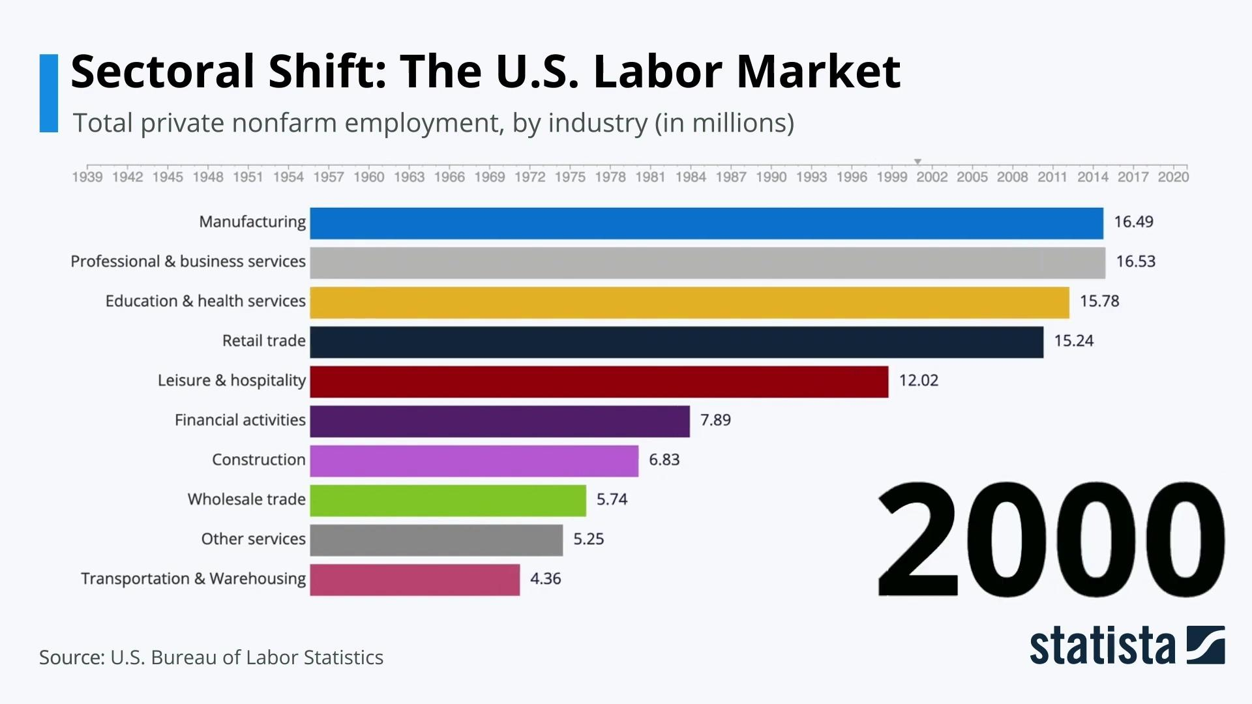
A specific data point

Slide 20
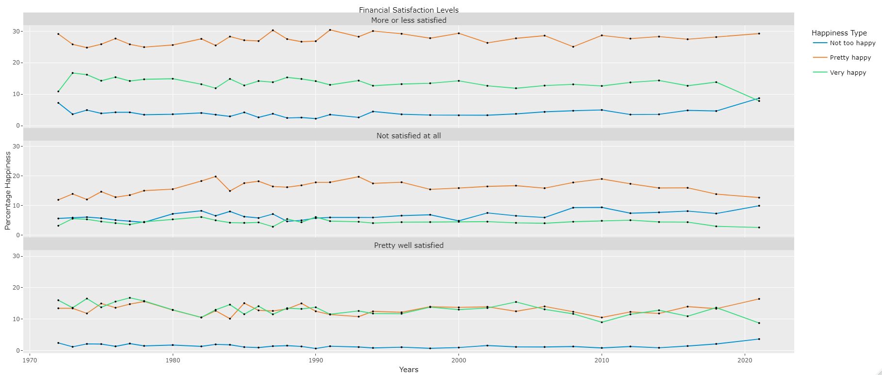
Happiness over Years by Financial Satisfaction

Slide 21
Not satisfied
More or less satisfied
Pretty well satisfied
Happiness over Years by Financial Satisfaction
Over the years, a net growth in not happy value is visible
Happiness percentage never broke the 20 percent barrier
Very happy percentage stays on the lowest of the lows.
They show highest values in pretty/moderately happy category
The pretty happy values hit major bottom twice in 1974 and 2008 and major tops in 1987, 1991 and 1994.
Moderately happy percentage value goes up discarding the general trend
Higher happiness value, lowest of the not happy value
pretty happy percentage values surpassing very happy values eighteen times from 1975 to 2021

Slide 22
06
Conclusion and Future Scope

Slide 23
Conclusion
Overall, happiness is related to job and financial satisfaction.
The more financially satisfied you are, the happier you are. In addition, the more satisfied you are with your job, the happier you are.
One might believe that money can't buy you happiness, but the data points out that money, along with a fulfilling job and financial satisfaction, has the potential to provide happiness.
Job fulfillment and financial security can make our life easier and more comfortable. It allows us to fulfill our needs and wants.

Slide 24
Future Scope
In the future, we can also observe relationship between job and financial satisfaction with the stress levels of individuals over the years.
It will be interesting to find connections with other similar variables like mental and physical health.
After gathering more data, we can also observe the short-term and long-term impact on individuals due to Covid-19 and how long it took for the numbers to return to Pre-Covid time.

Slide 25

Thank You

